Slide 1
Using machine learning methods to validate a discourse segment hypothesis
Jessica Cox, Corey A Harper, & Anita de Waard -- SAVE-SD
April 24, 2018

Slide 2
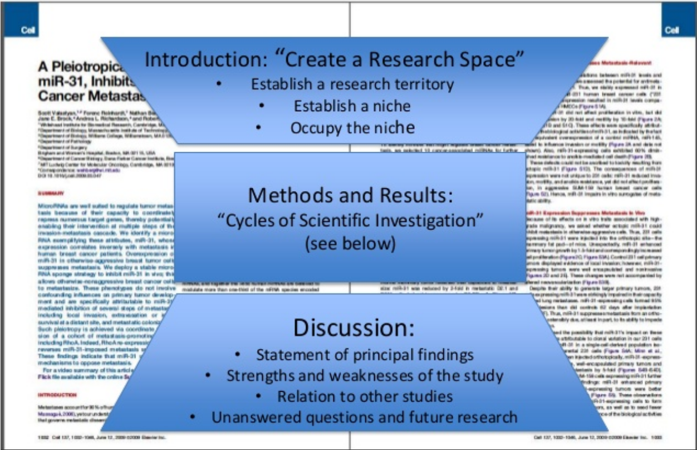
The IMRaD Structure of A Paper

Slide 3
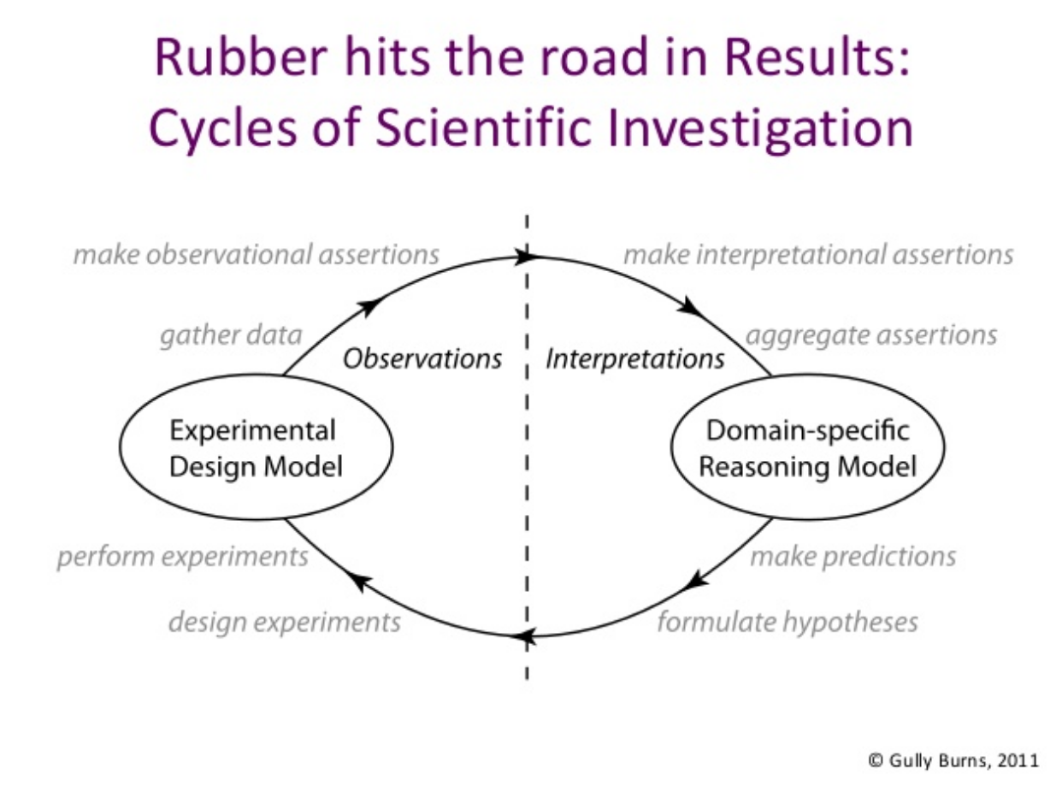

Slide 4

The Narrative Structure of Research Articles,
Or, Why Science is Like a Fairy Tale

Slide 5
Similar to a fairy tale…
Story Grammar |  | The Story of Goldilocks and the Three Bears
Setting | Time | Once upon a time
 | Character | a little girl named Goldilocks
 | Location | She went for a walk in the forest. Pretty soon, she came upon a house.
Theme | Goal | She knocked and, when no one answered,
 | Attempt | she walked right in.
Episode | Name | At the table in the kitchen, there were three bowls of porridge.
 | Subgoal | Goldilocks was hungry.
 | Attempt | She tasted the porridge from the first bowl.
 | Outcome | This porridge is too hot! she exclaimed.
 | Attempt | So, she tasted the porridge from the second bowl.
 | Outcome | This porridge is too cold, she said
 | Attempt | So, she tasted the last bowl of porridge.
 | Outcome | Ahhh, this porridge is just right, she said happily and
 | Outcome | she ate it all up.
Paper Grammar | The AXH Domain of Ataxin-1 Mediates Neurodegeneration through Its Interaction with Gfi-1/Senseless Proteins
Background | The mechanisms mediating SCA1 pathogenesis are still not fully understood, but some general principles have emerged.
Objects of study | the Drosophila Atx-1 homolog (dAtx-1) which lacks a polyQ tract,
Experimental setup | studied and compared in vivo effects and interactions to those of the human protein
Research goal | Gain insight into how Atx-1's function contributes to SCA1 pathogenesis. How these interactions might contribute to the disease process and how they might cause toxicity in only a subset of neurons in SCA1 is not fully understood.
Hypothesis | Atx-1 may play a role in the regulation of gene expression
Name | dAtX-1 and hAtx-1 Induce Similar Phenotypes When Overexpressed in Files
Subgoal | test the function of the AXH domain
Method | overexpressed dAtx-1 in flies using the GAL4/UAS system (Brand and Perrimon, 1993) and compared its effects to those of hAtx-1.
Results | Overexpression of dAtx-1 by Rhodopsin1(Rh1)-GAL4, which drives expression in the differentiated R1-R6 photoreceptor cells (Mollereau et al., 2000 and O'Tousa et al., 1985), results in neurodegeneration in the eye, as does overexpression of hAtx-1[82Q]. Although at 2 days after eclosion, overexpression of either Atx-1 does not show obvious morphological changes in the photoreceptor cells
Data | (data not shown),
Results | both genotypes show many large holes and loss of cell integrity at 28 days
Data | (Figures 1B-1D).
Results | Overexpression of dAtx-1 using the GMR-GAL4 driver also induces eye abnormalities. The external structures of the eyes that overexpress dAtx-1 show disorganized ommatidia and loss of interommatidial bristles
Data | (Figure 1F),

Slide 6
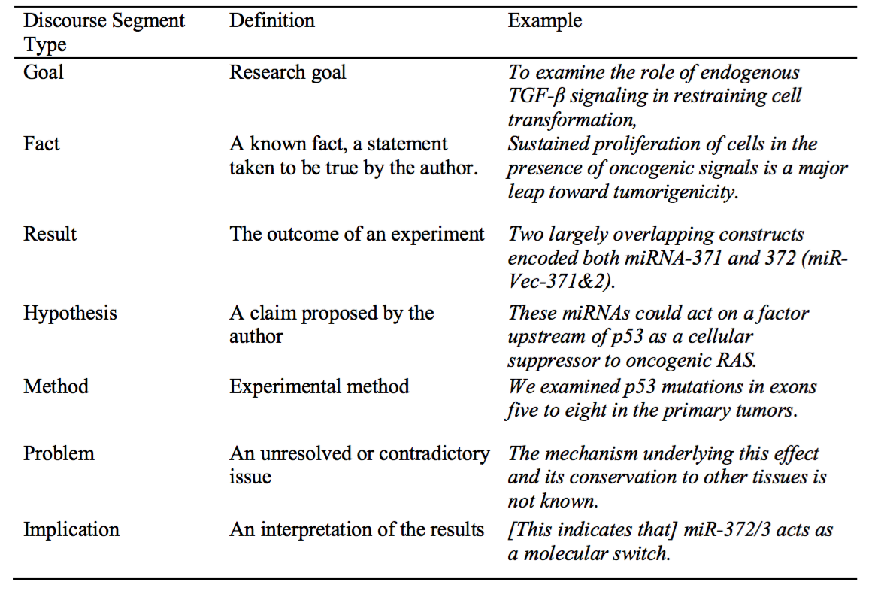
Discourse Segment Type (DST) Classification

Slide 7
Argumentation in the Results Section:
Importantly, our results so far indicate that the expression of miR-372&3 did not reduce the activity of RASV12, as these cells were still growing faster than normal cells and were tumorigenic, for which RAS activity is indispensable (Hahn et al, 1999 and Kolfschoten et al, 2005).
To shed more light on this aspect, we examined the effect of miR-372&3 expression on p53 activation in response to oncogenic stimulation.
We used for this experiment BJ/ET cells containing p14ARFkd because, following RASV12 treatment, in those cells p53 is still activated but more clearly stabilized than in parental BJ/ET cells (Voorhoeve and Agami, 2003), resulting in a sensitized system for slight alterations in p53 in response to RASV12.
Figure 4A shows that following RASV12 stimulation, p53 was stabilized and activated, and its target gene, p21cip1, was induced in all cases, indicating an intact p53 pathway in these cells.
Reg-clause | Fact | Goal | Method | Result | Implication
Hypothesis (not shown) | Problem (not shown)

Slide 8
Potential Applications
Text Summarization
Hypothesis Formulation
Citation Analysis
Identifying Methods and Protocols
For extraction to Lab Notebooks
Knowledge Extraction
Is extracted data a hypothesis, claim, or fact?
Figure and Table Interpretation
Which figures represent your ”results”

Slide 9
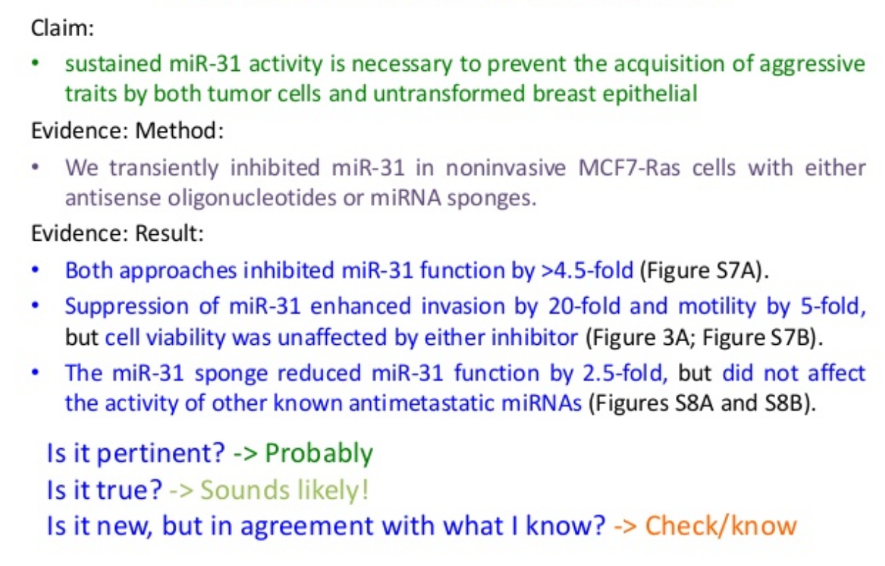
Networks of Claims and Evidence

Slide 10
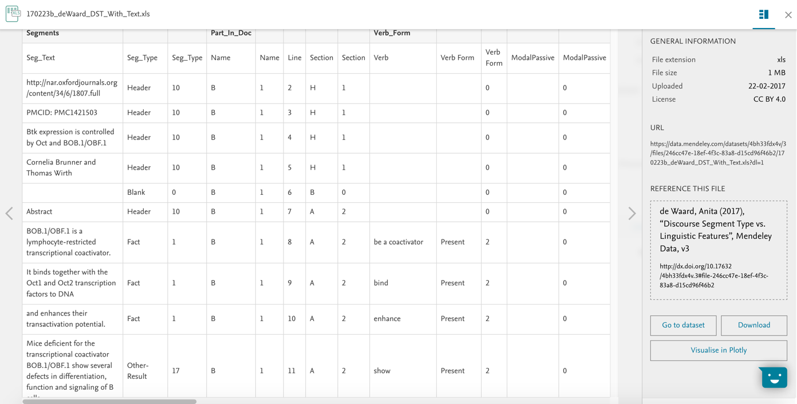
Dataset of “Discourse Segment Type vs. Linguistic Features”
https://data.mendeley.com/datasets/4bh33fdx4v/3

Slide 11
Features / Feature Groups
Frequently Used Verb
Top 10 Verb | ”Show” verb
Verb Tense
Future | Gerund | Past | Past participle | Past perfect
Past progressive | Present | Present perfect | Present progressive | To-infinitive
Verb Class
Cause and effect | Change and growth | Discourse verb | Interpretation | Investigation
None | Observation | Prediction | Procedure | Properties
Modality Marker
Modal | Verb class interpretation | Ruled by verb class interpretation | Reference internal | Reference external
First person | Modal significant_ly | Possible_ility_ly | Potential_ly | UN_Likely
Sum_Adverbs_YesNO

Slide 12
Summary Statistics

Slide 13
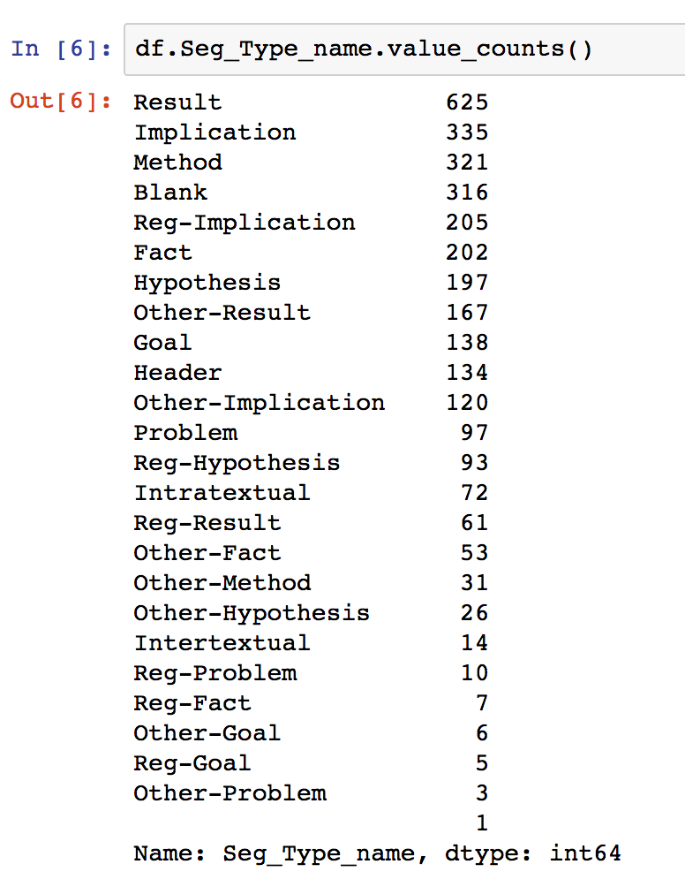
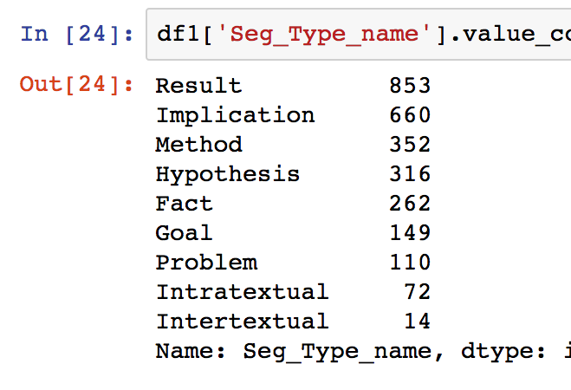
Class Distribution
Collapsed and Filtered
Subcategories normalized to parent
Blank and Header rows removed
Intertextual and Intratextual removed

Slide 14
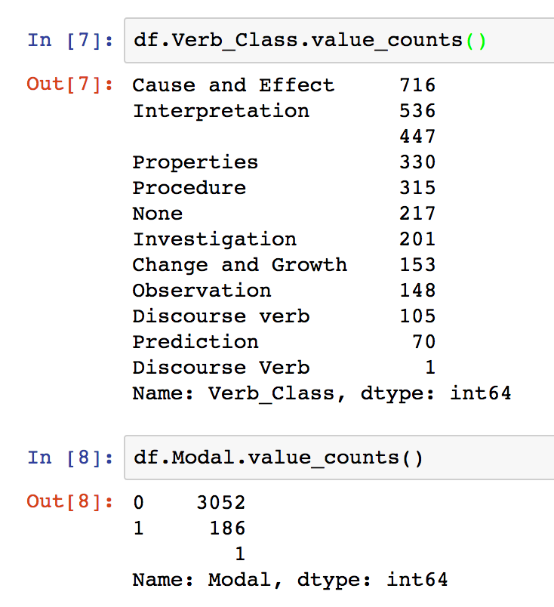
Verb Class & Modality Distributions

Slide 15
Machine Learning Models

Slide 16
Methods Explored
Baseline: Logistic Regression, Decision Tree, Random Forest
Same classifiers using Class Balancers
SciDT Neural Network for comparison
Feature Reduction / Ablation
Mini-experiment with binary targets and limited feature set

Slide 17
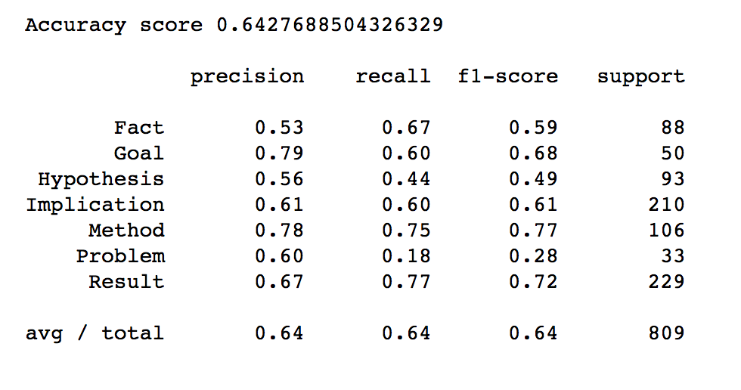
Baseline Random Forest Results

Slide 19
RandomUnderSampler | Undersamples the majority classes by randomly picking samples
Tomeklinks | Undersamples the majority classes by removing Tomek’s links
ClusterCentroids | Under samples the majority classes by replacing a cluster of the majority samples by the cluster centroid of a KMeans algorithm
CondensedNearestNeighbor | Under samples the majority classes using the condensed nearest neighbor method
OneSidedSelection | Uses one-sided selection method on majority classes
InstanceHardnessThreshold | Samples with lower probabilities are removed from the majority class
RandomOverSampler | Randomly generates new samples from the minority classes
SMOTE | Synthetic Minority Oversampling Technique; generates new samples of minority class by interpolation
SMOTEborderline | Generates new samples of minority class specific to the borders between two classes.
SMOTEborderline2 | Generates new samples of minority class specific to the borders between two classes.
SMOTETomek | Combines use of SMOTE on minority class and Tomek Links on majority class
SMOTEENN | Combines use of SMOTE on minority class and Edited Nearest Neighbors on majority class

Slide 20
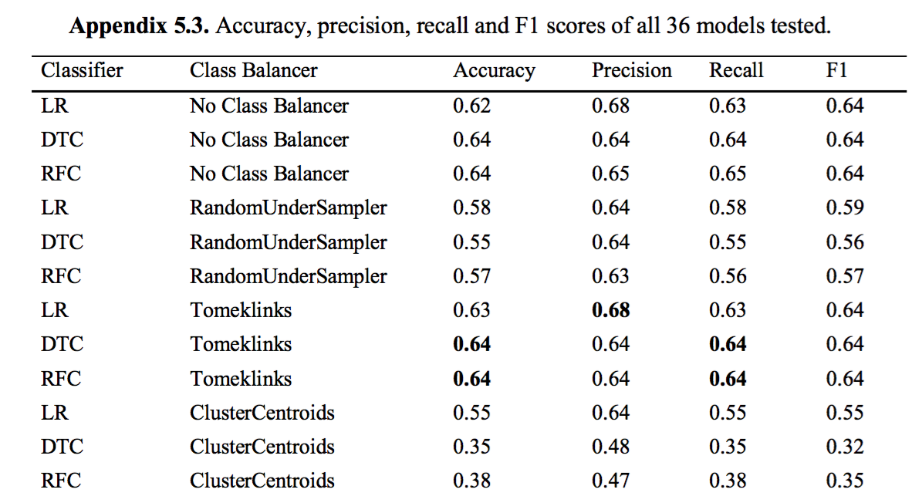
Class balancers had minimal to no effect

Slide 21
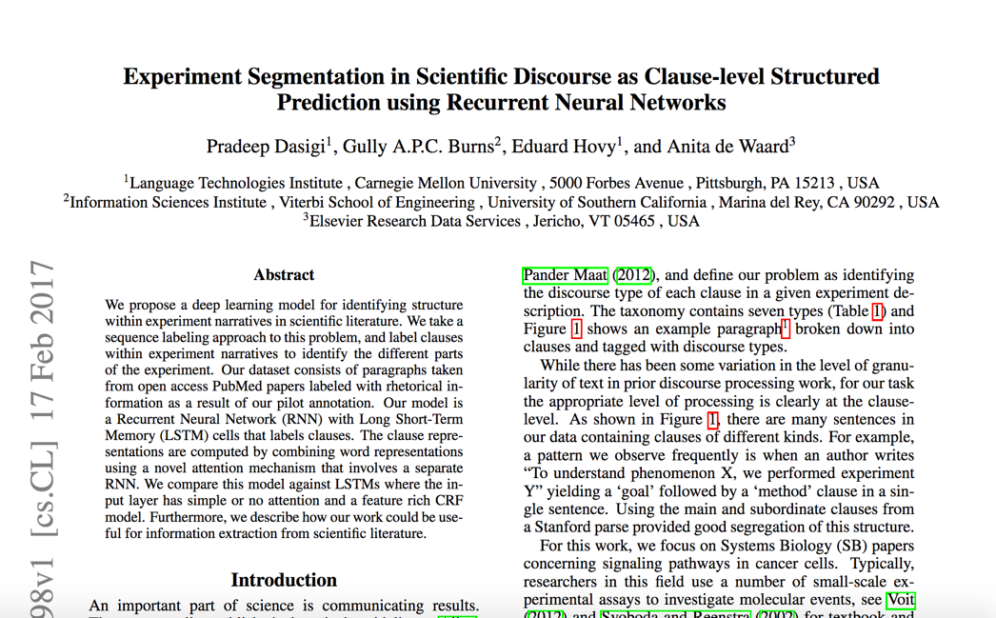
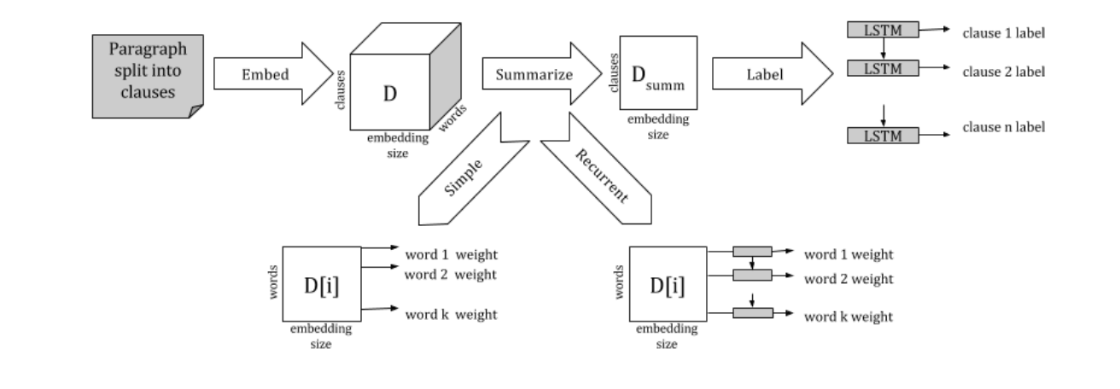
Scientific Discourse Tagger
https://github.com/edvisees/sciDT
https://arxiv.org/pdf/1702.05398.pdf

Slide 22
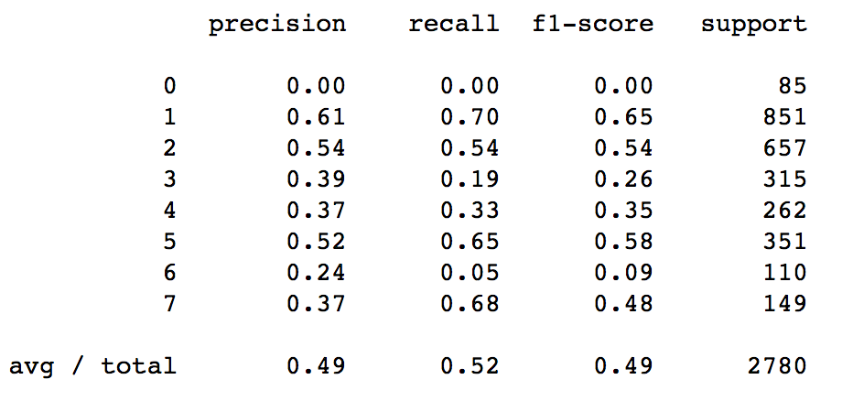

Slide 23
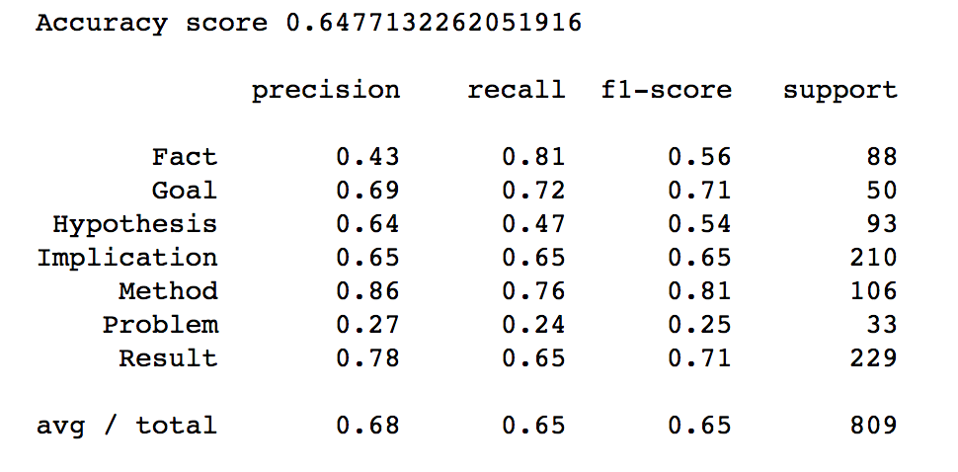
Feature Reduction and Forward Ablation
Reduce to 13 Features: F1 increases .65 before dropping

Slide 24
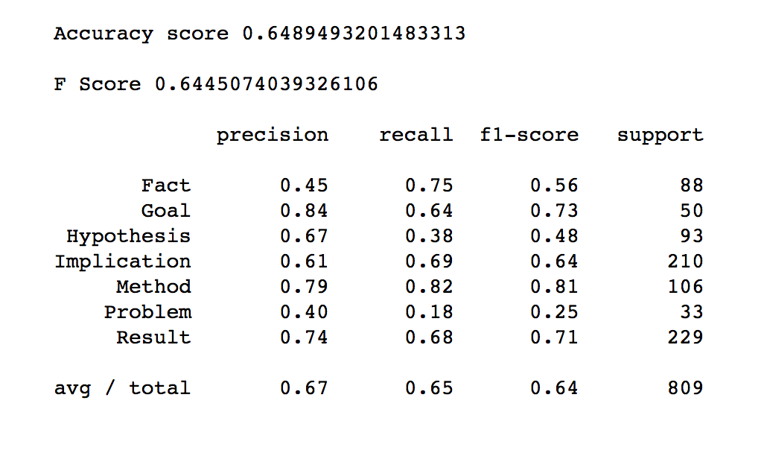
Feature Reduction and Forward Ablation
Forward Ablation to 9 Features before F1 levels off.

Slide 25
Minimal Change to Confusion Matrix
All Features
9 Features

Slide 26
Significant Features
Feature Class | Feature
Verb Tense | Past
Verb Tense | Present
Verb Tense | To-infinitive
Verb Class | Interpretation
Verb Class | Investigation
Verb Class | Procedure
Modality Marker | Modal
Modality Marker | Verb class interpretation
Modality Marker | Ruled by verb class interpretation

Slide 27
Verb Tense Mini-Experiment
Binary Verb Tense Features
Future
Gerund
Past
Past participle
Past perfect
Past progressive
Present
Present perfect
Present progressive
To-infinitive
Binary Class Labels
Result/Method
Fact/Implication

Slide 28
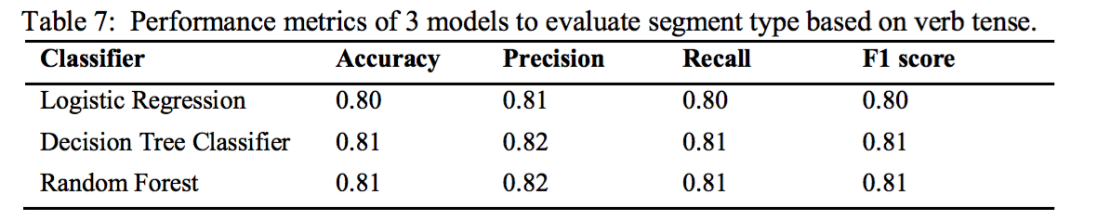
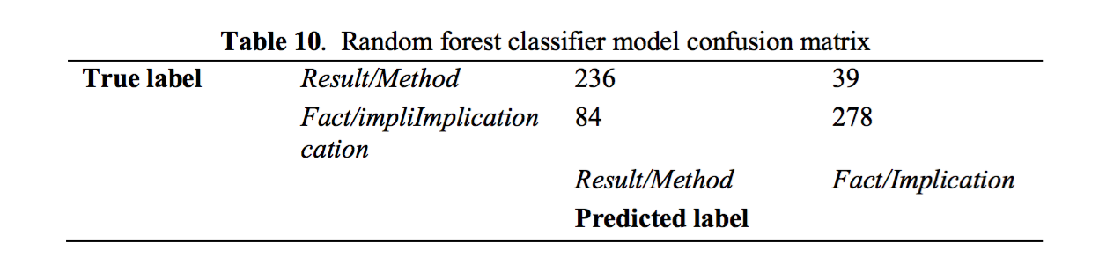

Slide 29
Conclusions
And
Future Work

Slide 30
Conclusions
Verb tense, class, and modality are reasonably good predictors of discourse segment type
Class prediction success doesn’t line up with majority / minority classes
Verb tense alone is very good at distinguishing Result/Method from Fact/Implication
There are some limits to our methodology

Slide 31
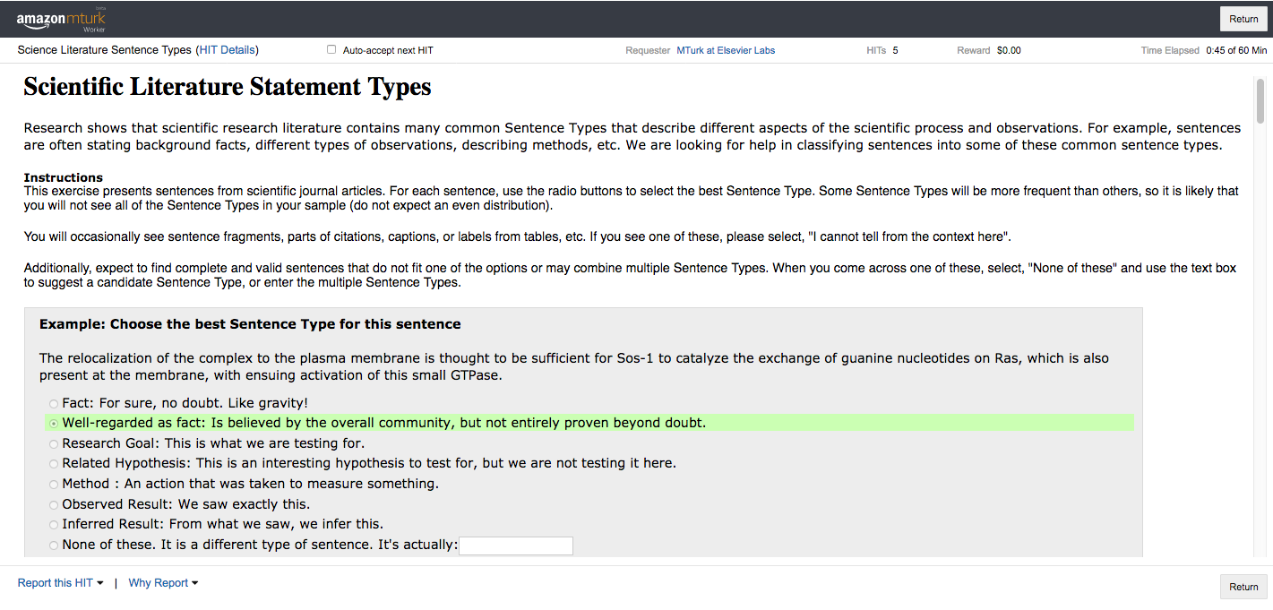
Future Work
Build larger training sets of segment types
Mechanical Turk experiment underway

Slide 32
Future Work
Evaluate automated extraction of features
Looking at Snorkel as a a tool for merging multiple noisy classifiers
Majority voting: F1 of .64
Generative model: F1 of .58
Based on Sujit Pal’s post: http://sujitpal.blogspot.co.uk/2018/01/cleaning-up-noisy-labels-using-snorkels.html

Slide 33
Corey A Harper
@chrpr
c.harper@elsevier.com
We’re hiring!

